Slide 1
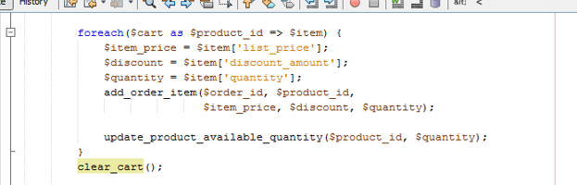
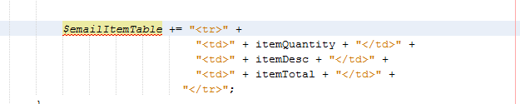
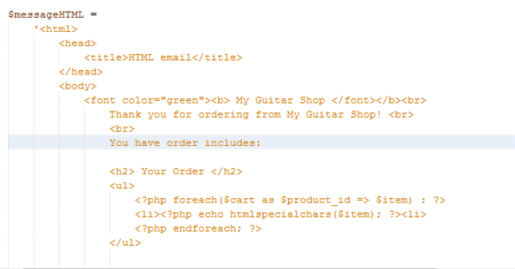
Overview: Try this. Use the foreach statement to
Cycle through like you were but add
some additional lines that would add
HTML/PHP coding to a different string variable. What
this would do is force the foreach to
create a table for you to use in the $messageHTML
variable. ***Note, I grab the example
from a different language so you’ll want to change
the syntax to PHP. The concept should work though.
* To get this to work right you would code this variable right before the foreach loop so that it is accessible to the foreach loop and the rest of the code.
* You’ll also want to use an operate that continually adds to the string vs overwriting it.
Pull the $emailItemTable variable into the $messageHTML message right here instead of the foreach loop and that should essentially insert a table. You can also do that with the UL/Lis you’re trying to use

